Slide 1
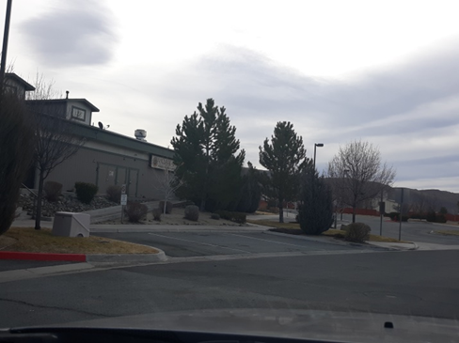
ADMINISTRATIVE CASE NUMBER WADMIN19-0022 (Lullaby Nursery)
Washoe County Board of Adjustment
February 6, 2020

Slide 2
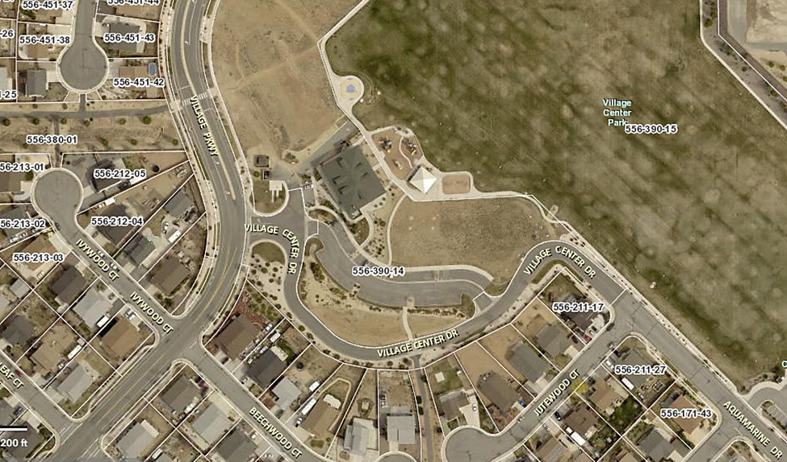

Request
Approve a Child Daycare facility for up to 15 children in an existing commercial building.

Slide 3
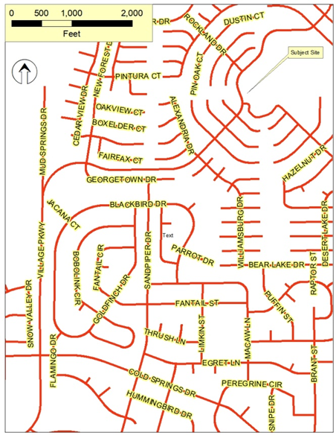
Vicinity Map

Slide 4
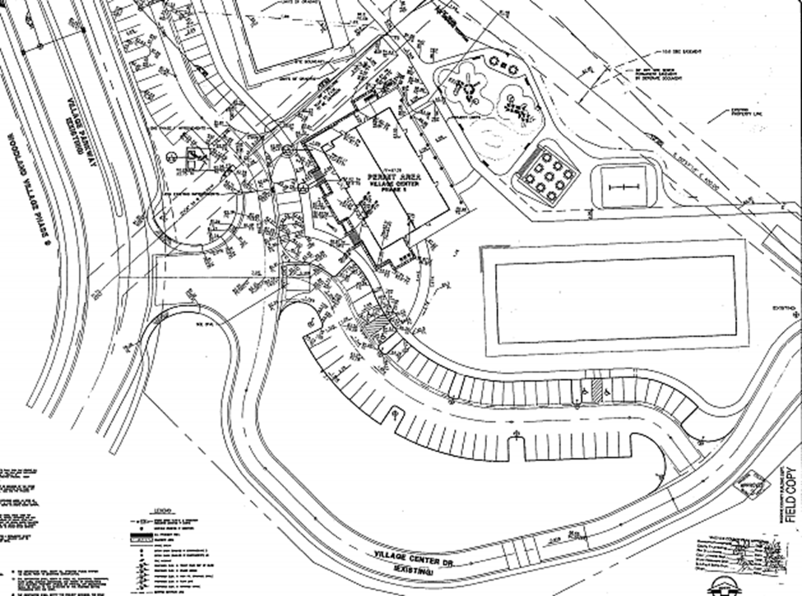
Site Plan

Slide 5
Evaluation
Flat lot
Existing commercial building
Meets general landscaping and parking code requirements
Conditions of approval have been recommended to comply with current Building code, within the structure

Slide 6
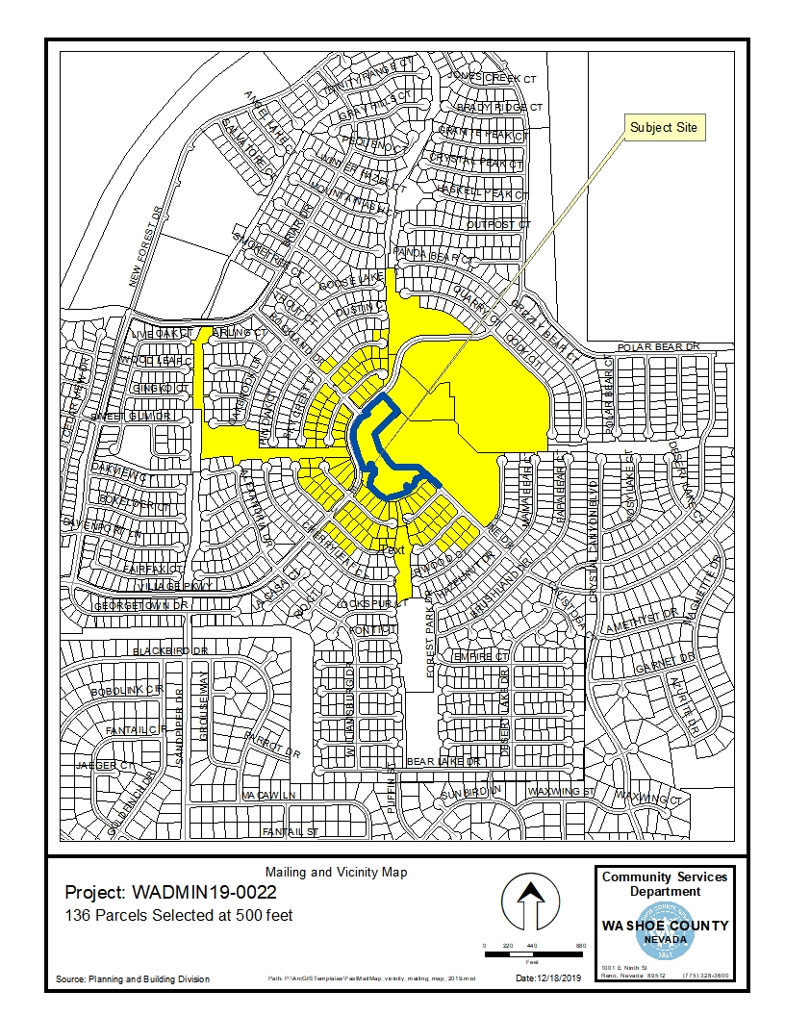
Public Notice & CAB
Notice sent to 136 affected property owners
North Valleys CAB reviewed the application on January 13, 2020 and recommended approval

Slide 7
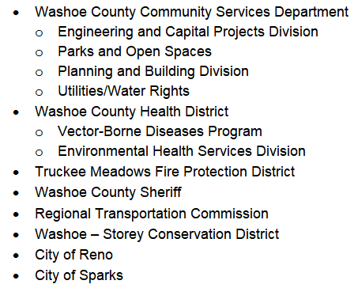
Reviewing Agencies

Slide 8
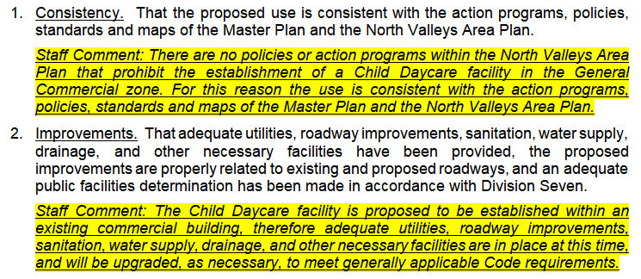
Administrative Permit Findings
Page 8 of staff report

Slide 9
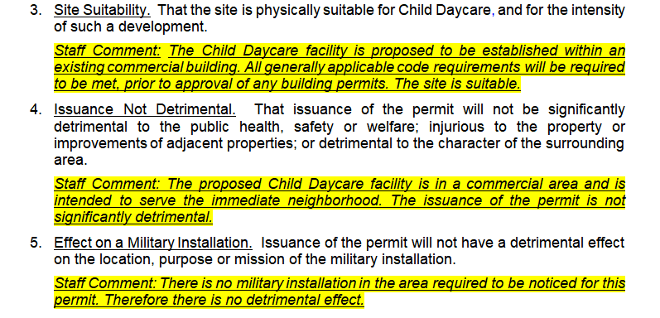
Administrative Permit Findings

Slide 10
Recommendation
After a thorough analysis and review, Administrative Permit Case Number WADMIN19-0022 is being recommended for approval with conditions.

Slide 11
Possible Motion (Page 9)
I move that, after giving reasoned consideration to the information contained in the staff report and information received during the public hearing, the Board of Adjustment approve Administrative Permit Case Number WADMIN19-0022 for Lullaby Nursery LLC, having made all five findings in accordance with Washoe County Development Code Section 110.808.25.1.

